Slide 1
Unit 5
CLOUD DELIVERY MODEL CONSIDERATIONS

Slide 2
CONCEPTS
CLOUD DELIVERY MODELS : THE CLOUD PROVIDER PERSPECTIVE
2. CLOUD DELIVERY MODELS : THE CLOUD CONSUMER PERSPECTIVE

Slide 3
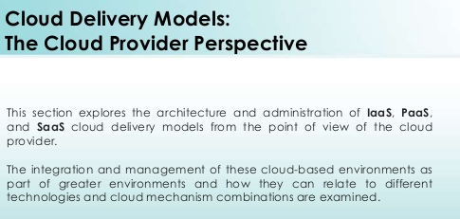

Slide 4
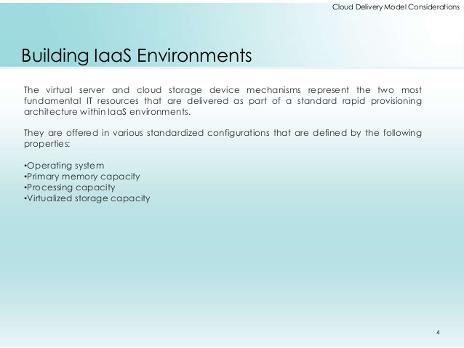

Slide 5
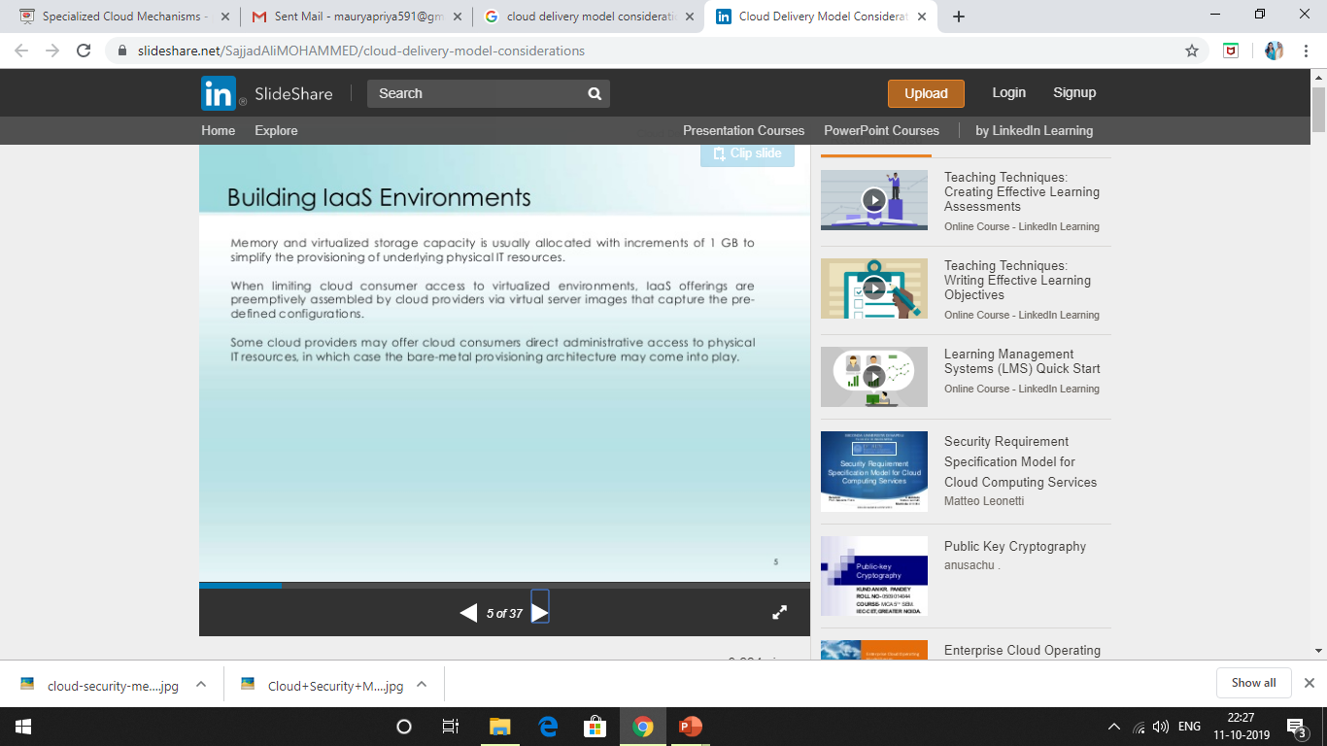

Slide 6
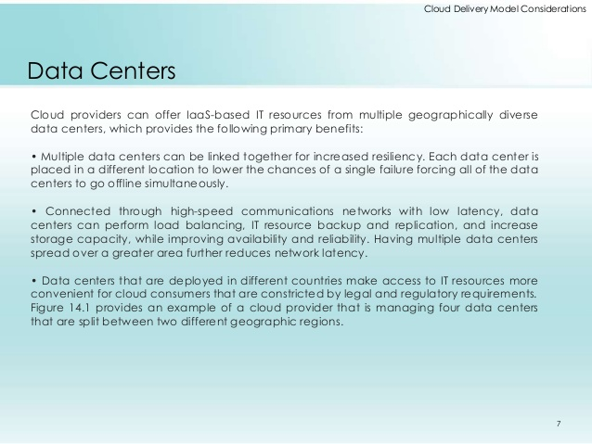

Slide 7


Slide 8
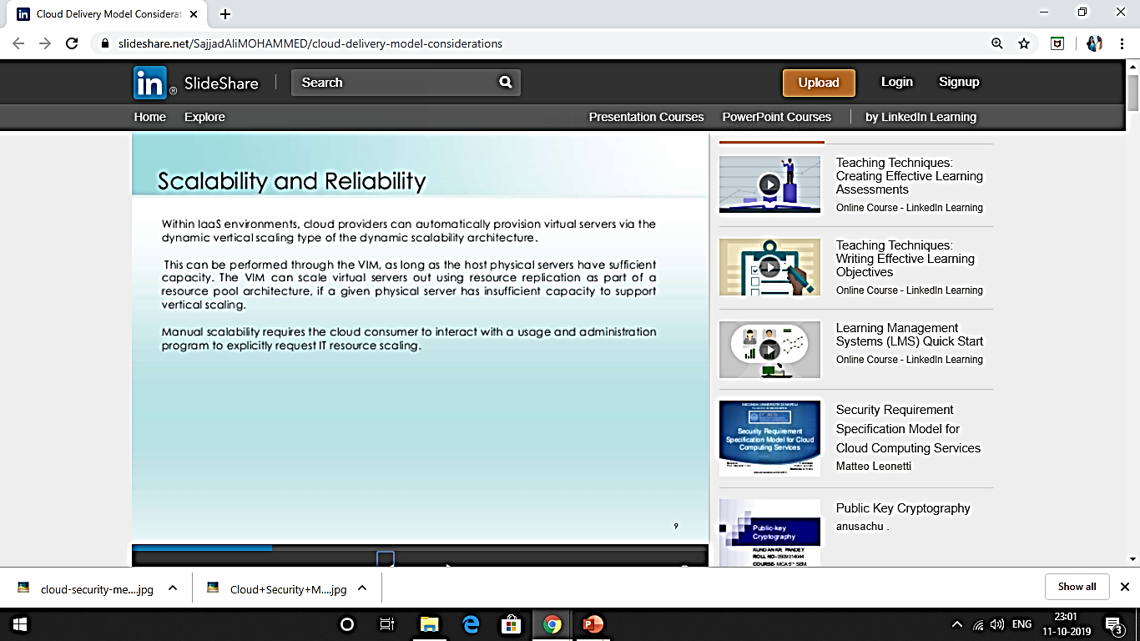

Slide 9
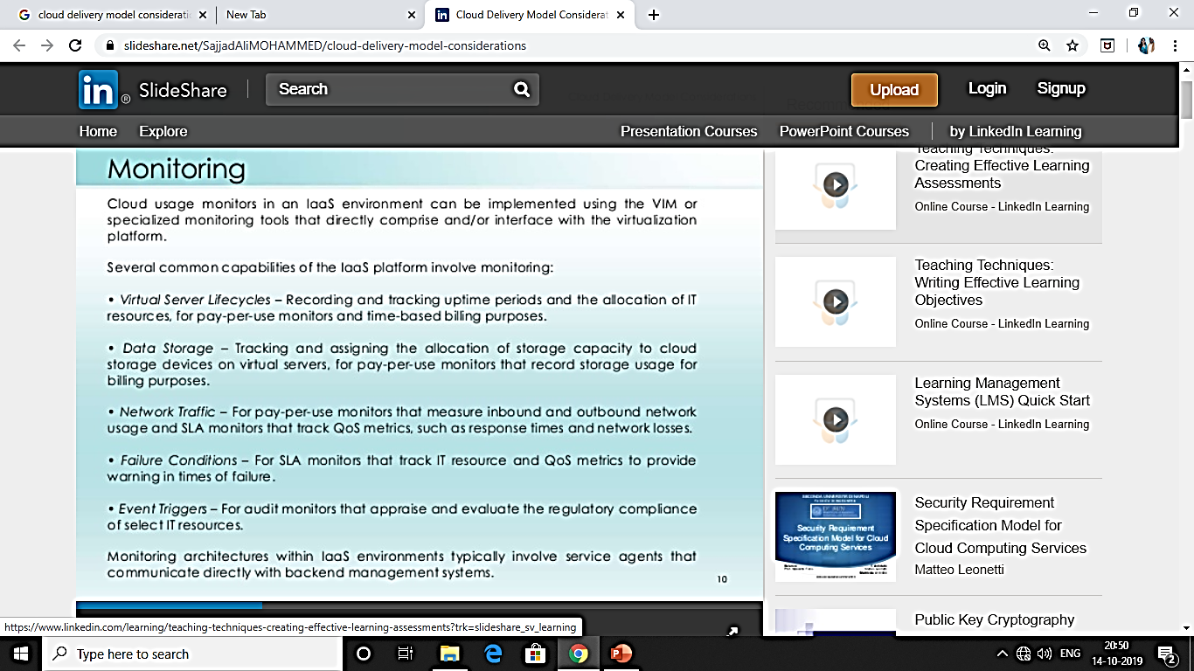

Slide 10
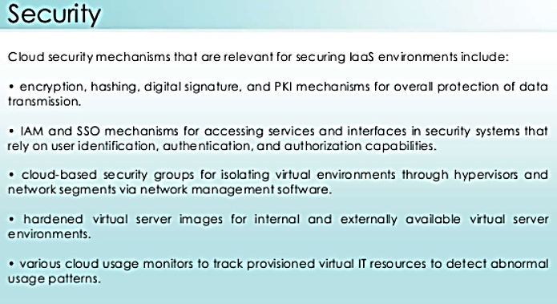

Slide 11
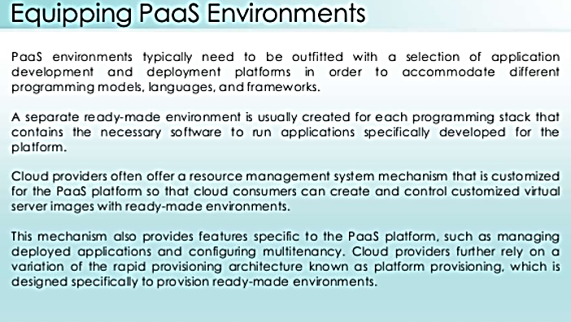

Slide 12
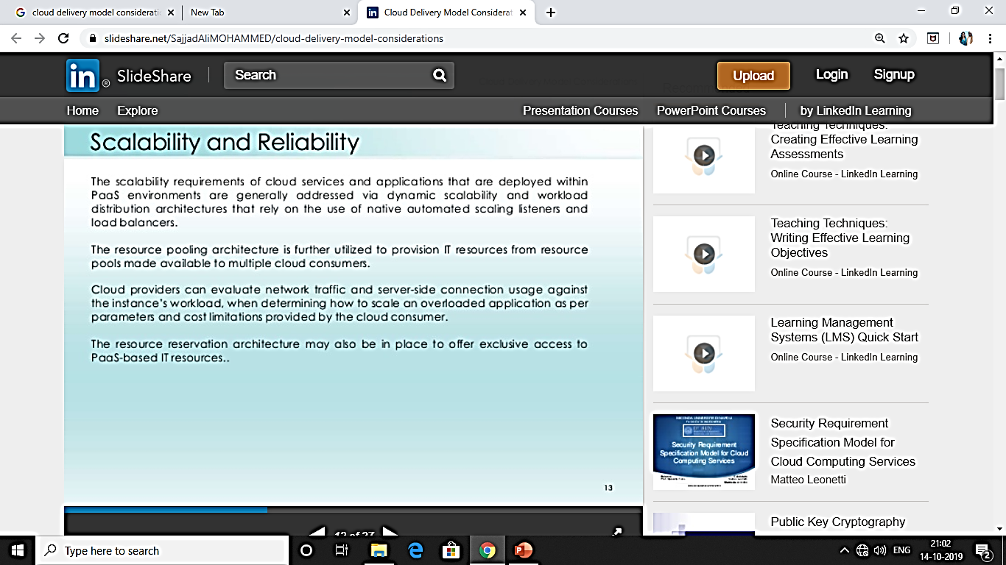

Slide 13


Slide 14
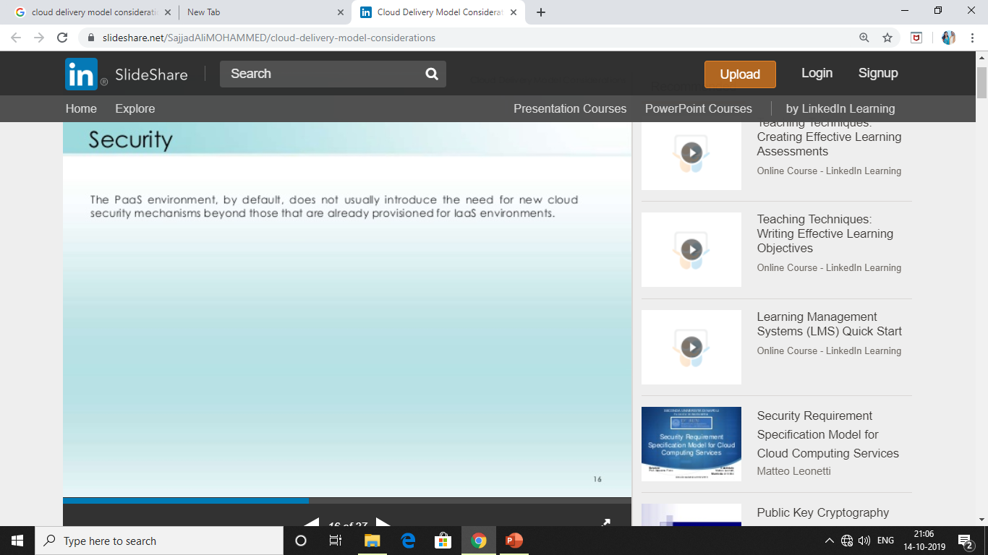

Slide 15
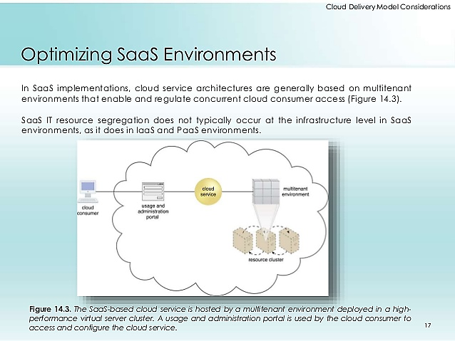

Slide 16
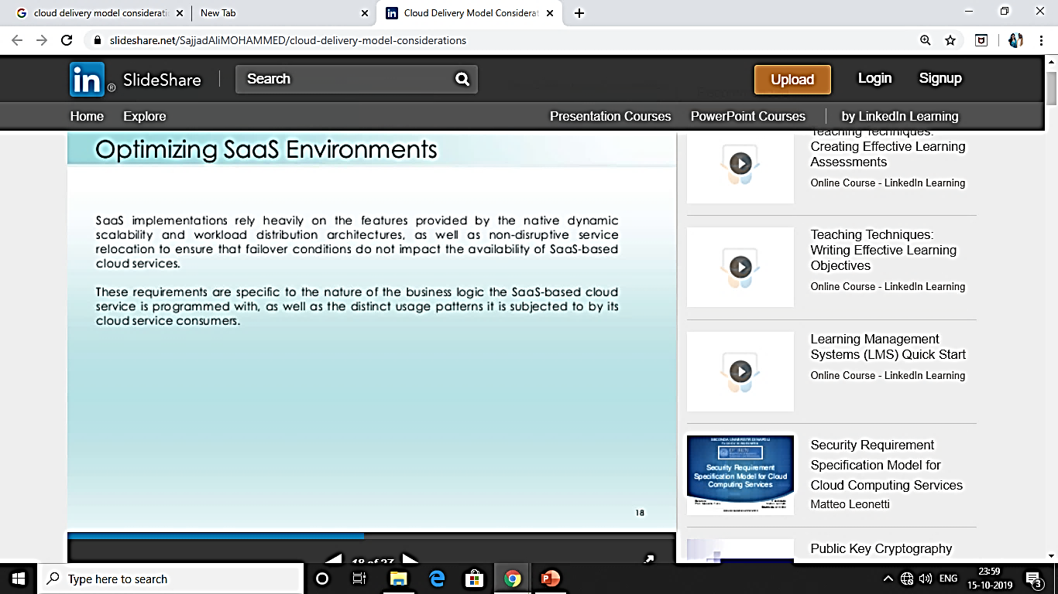

Slide 17
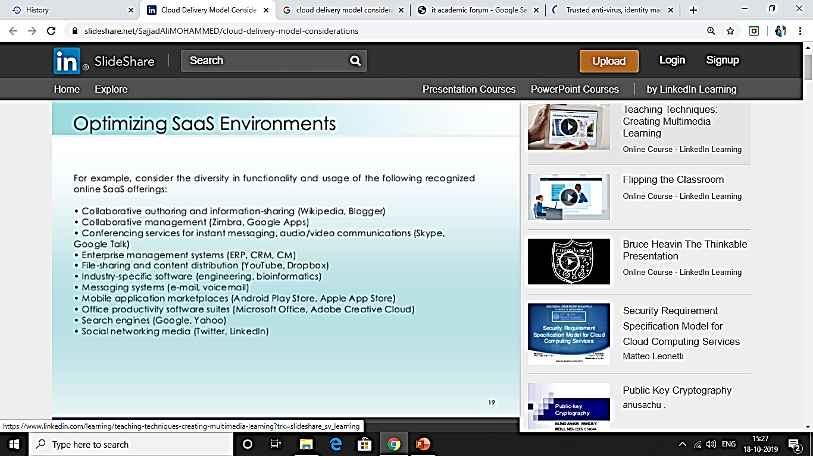

Slide 18


Slide 19


Slide 20
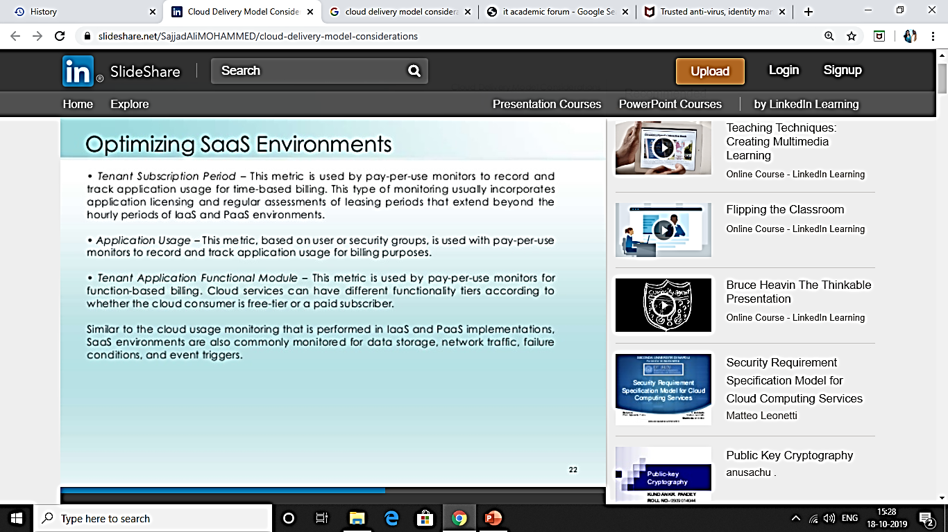

Slide 21
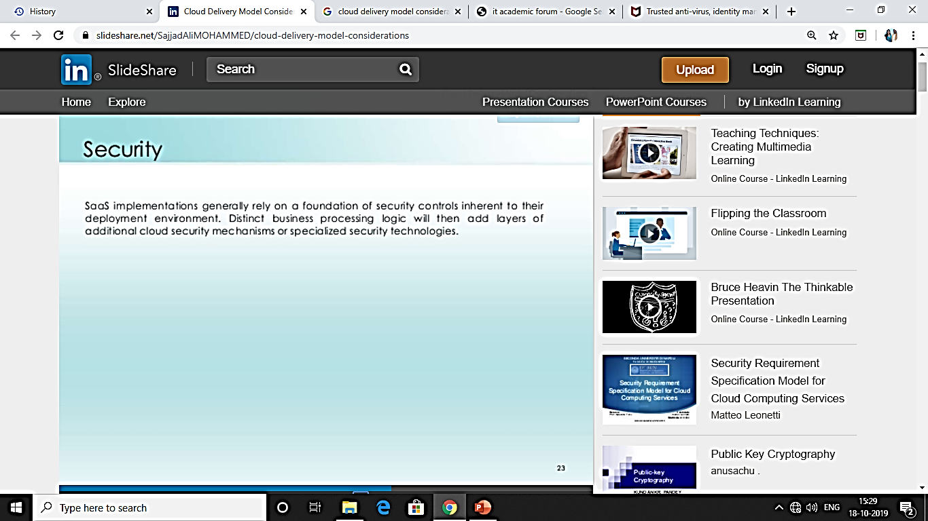

Slide 22
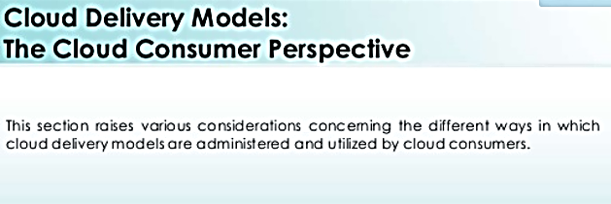

Slide 23


Slide 24
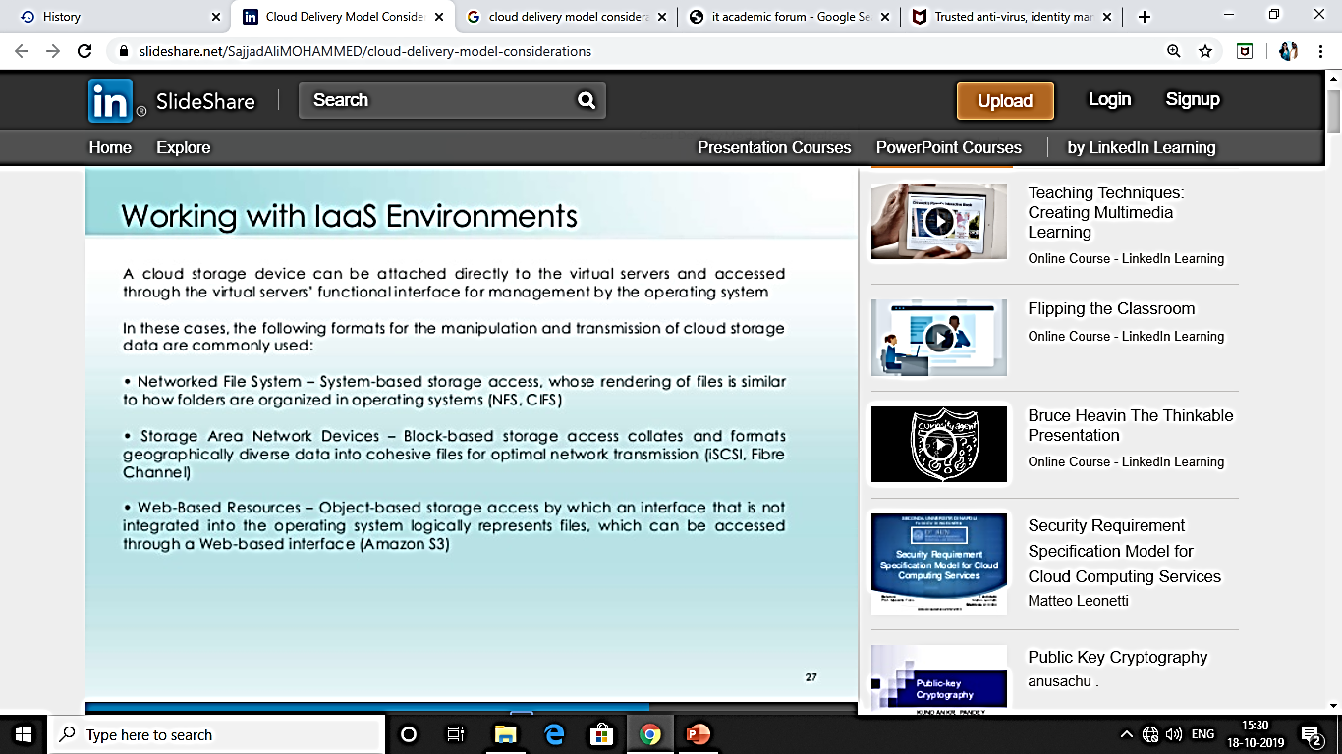

Slide 25


Slide 26
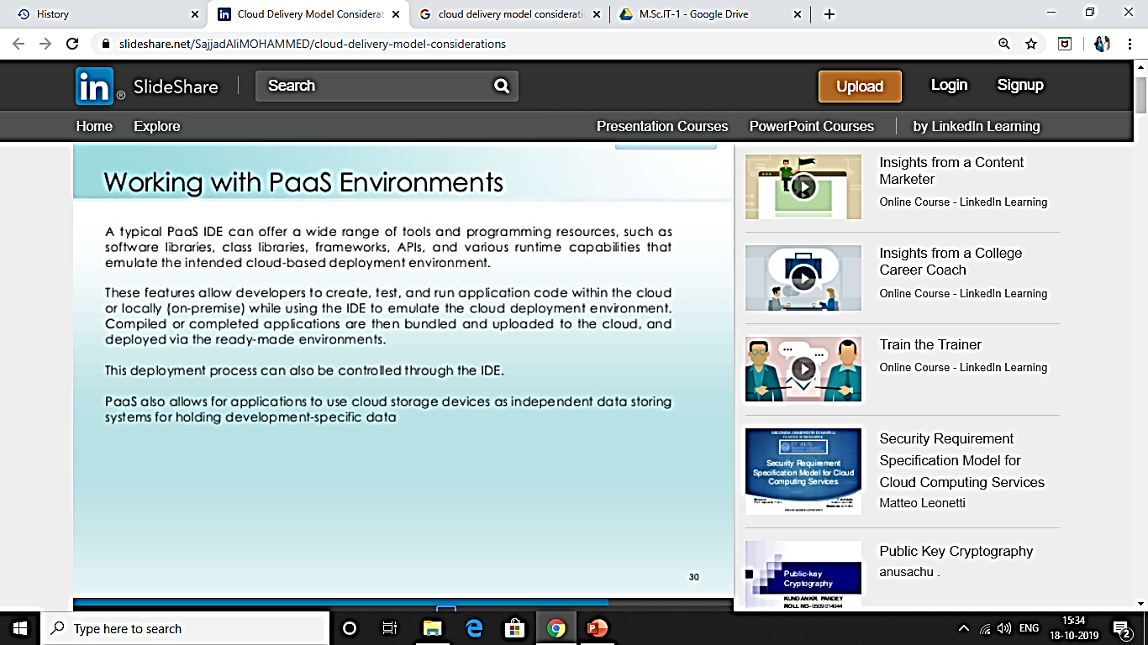

Slide 27
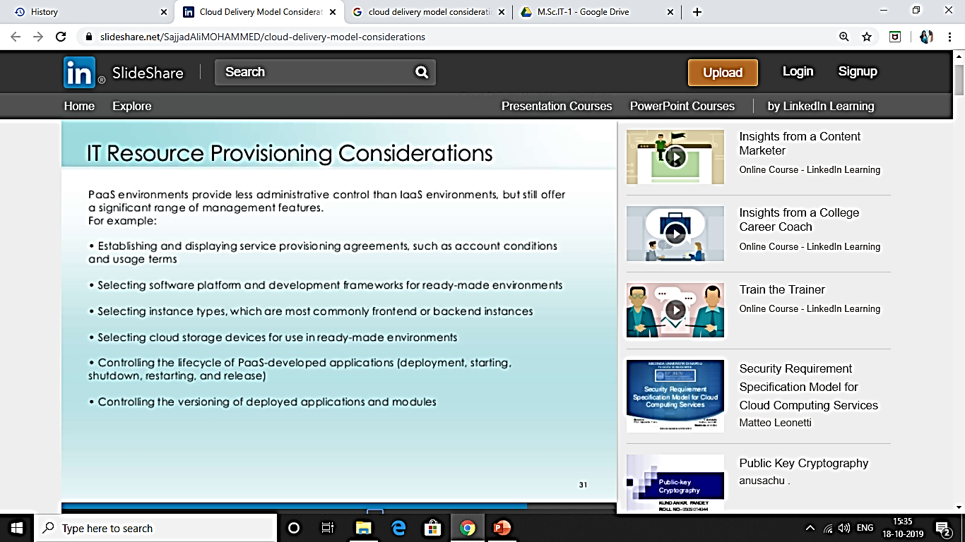

Slide 28
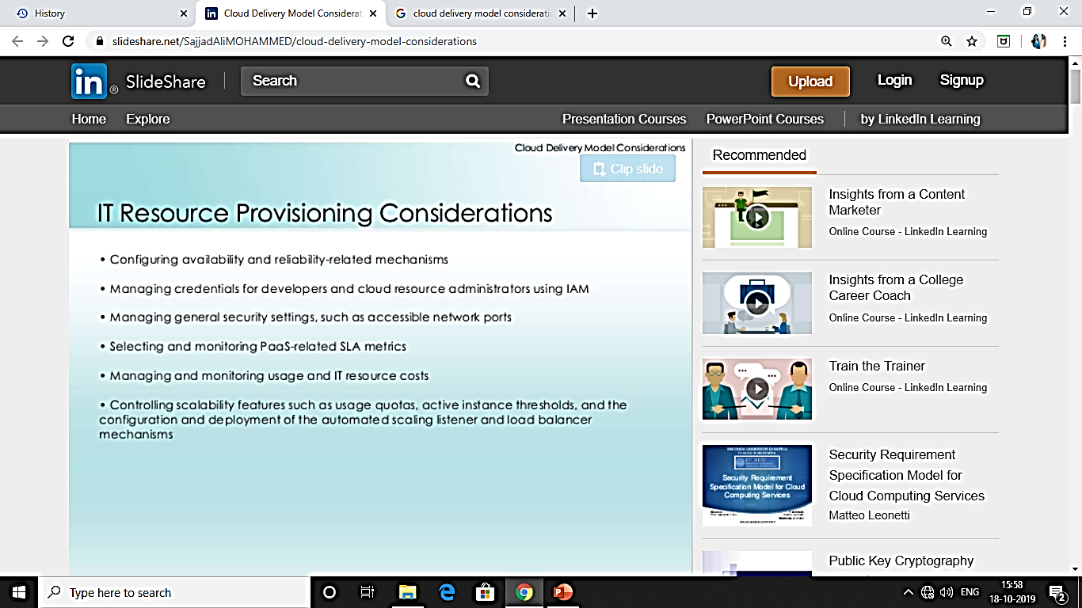

Slide 29
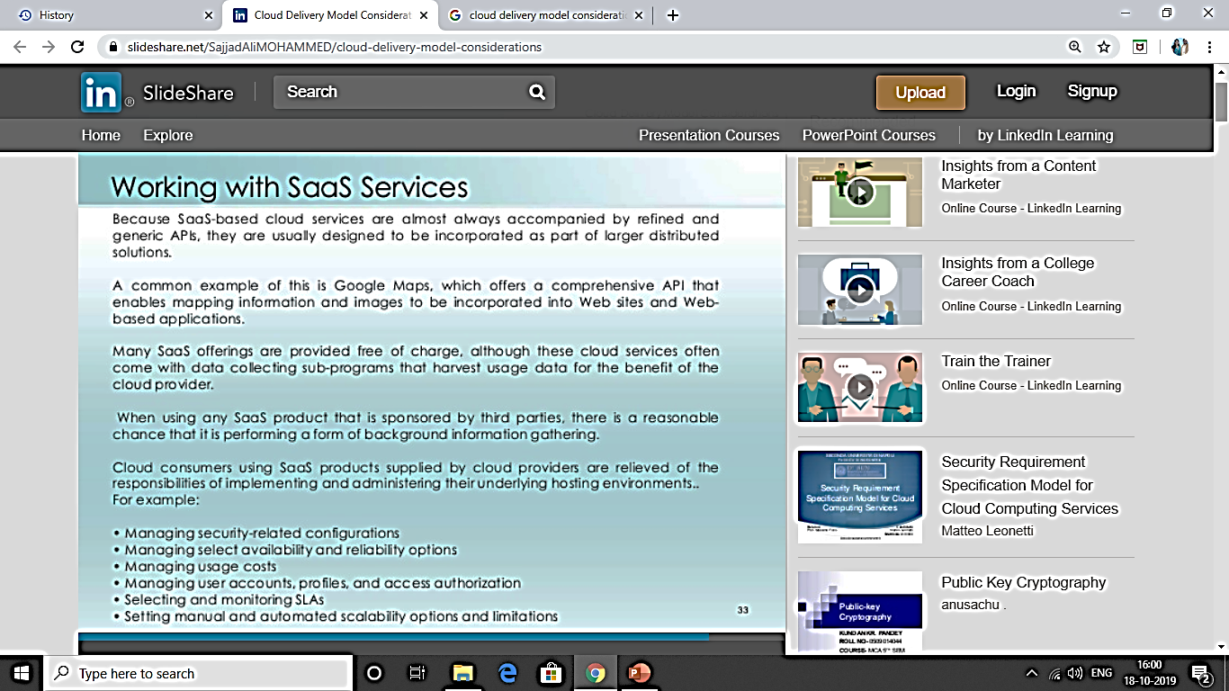

Slide 30
CHAPTER 2 COST METRICES AND PRICING MODELS
BUSINESS COST METRICES
CLOUD USAGE COST METRICES
COST MANAGEMENT CONSDERATIONS

Slide 31
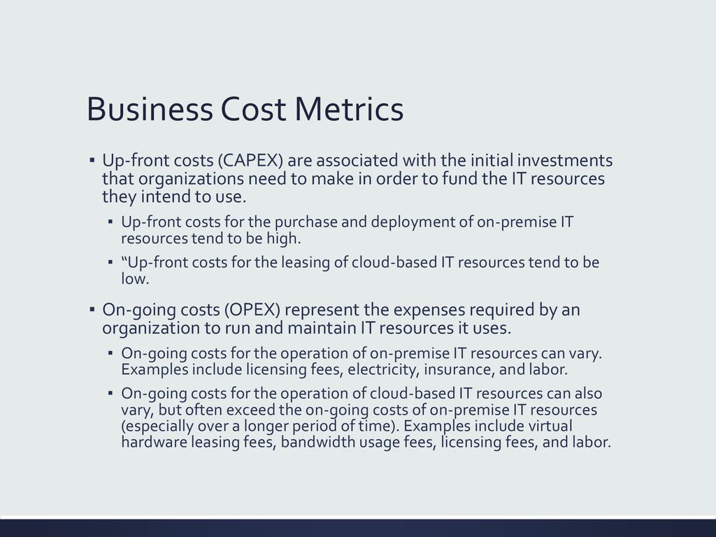

Slide 32
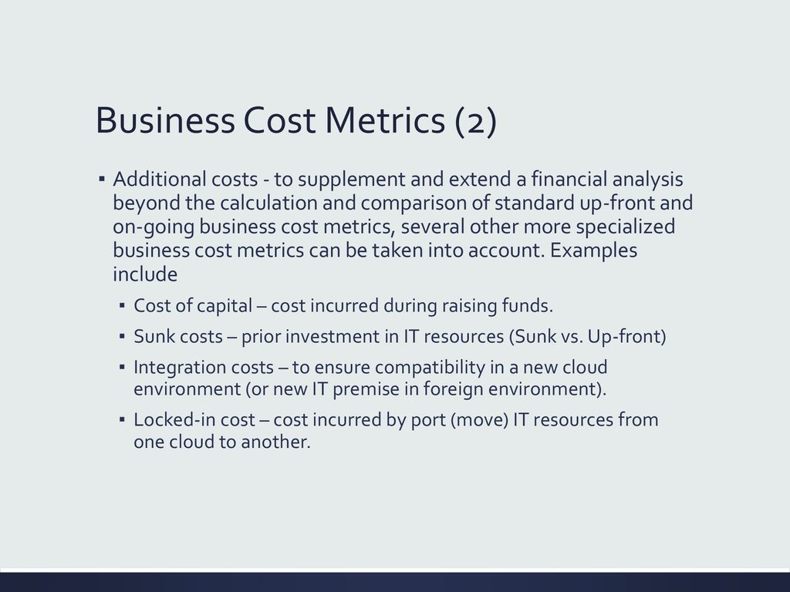

Slide 33
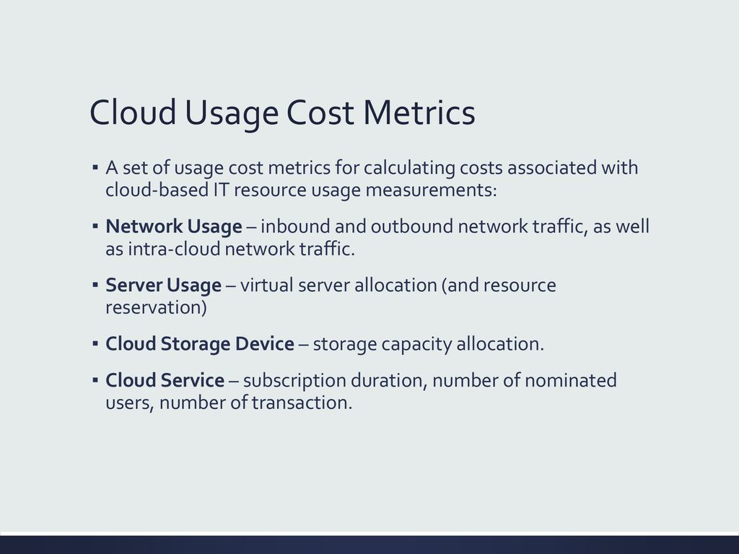

Slide 34
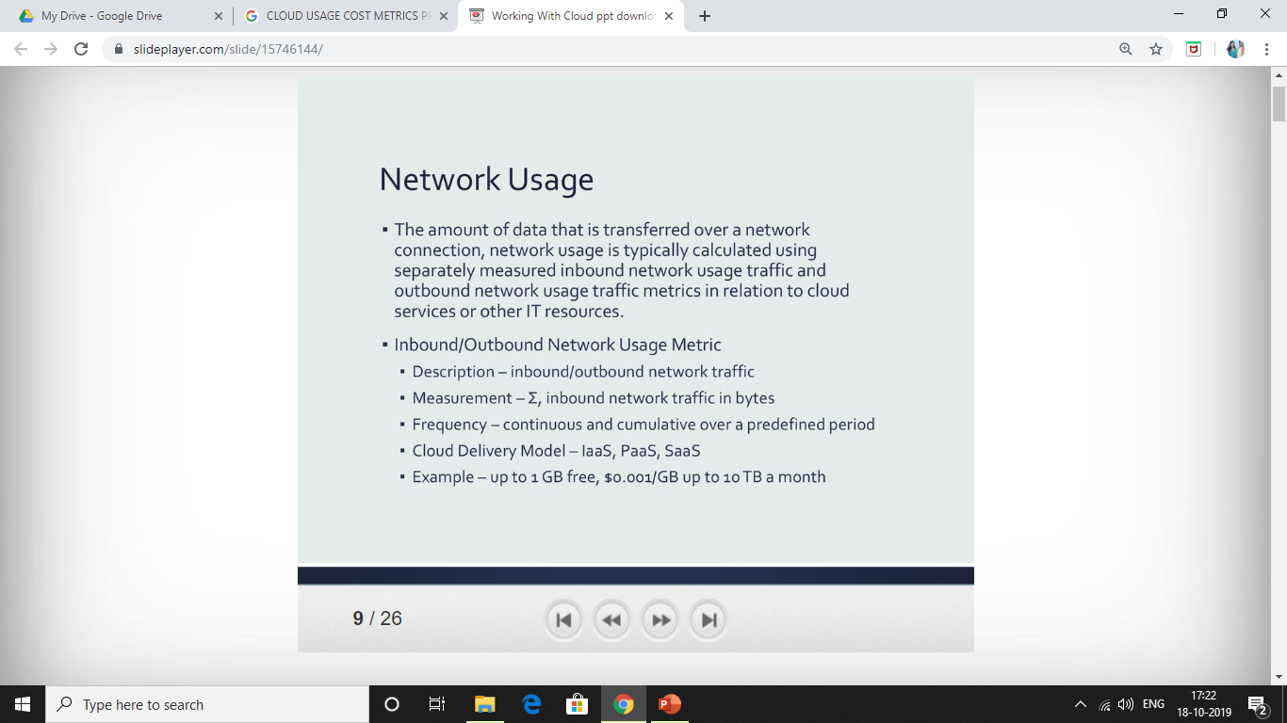

Slide 35
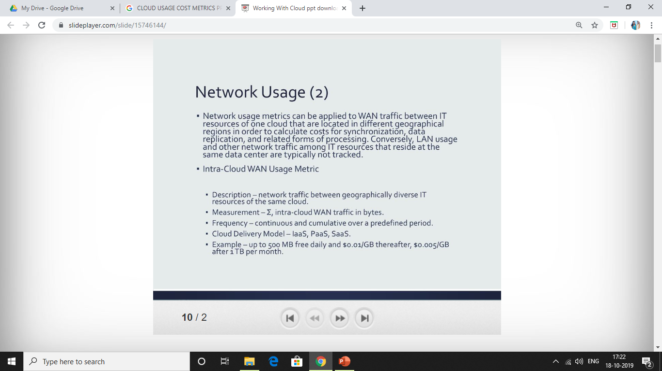

Slide 36
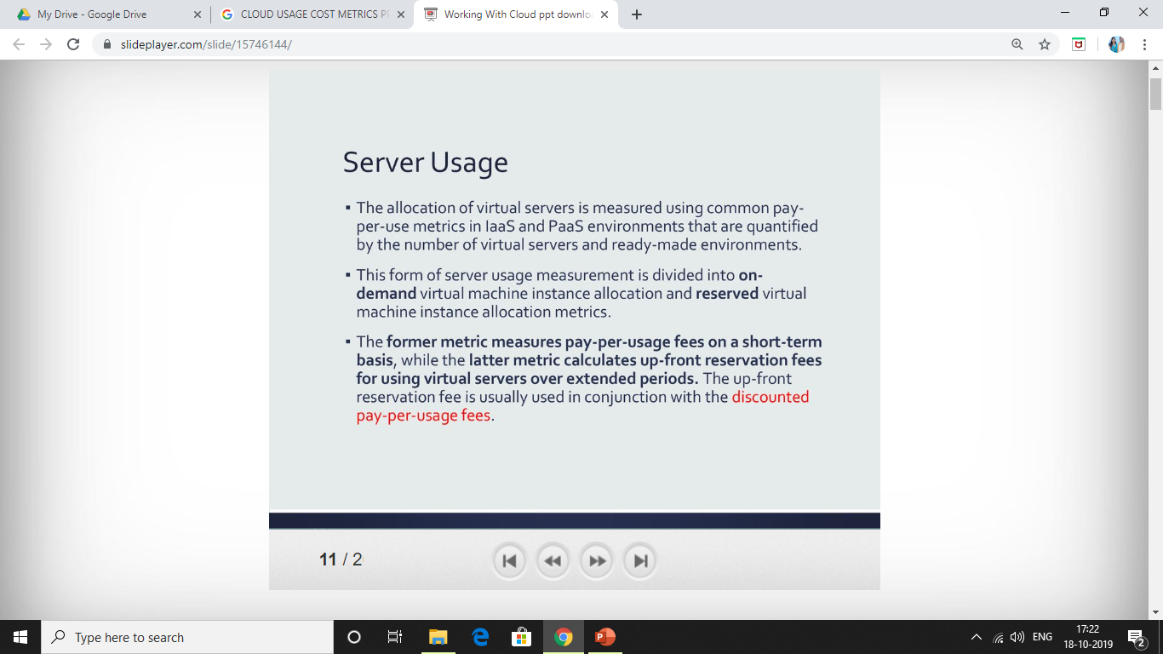

Slide 37
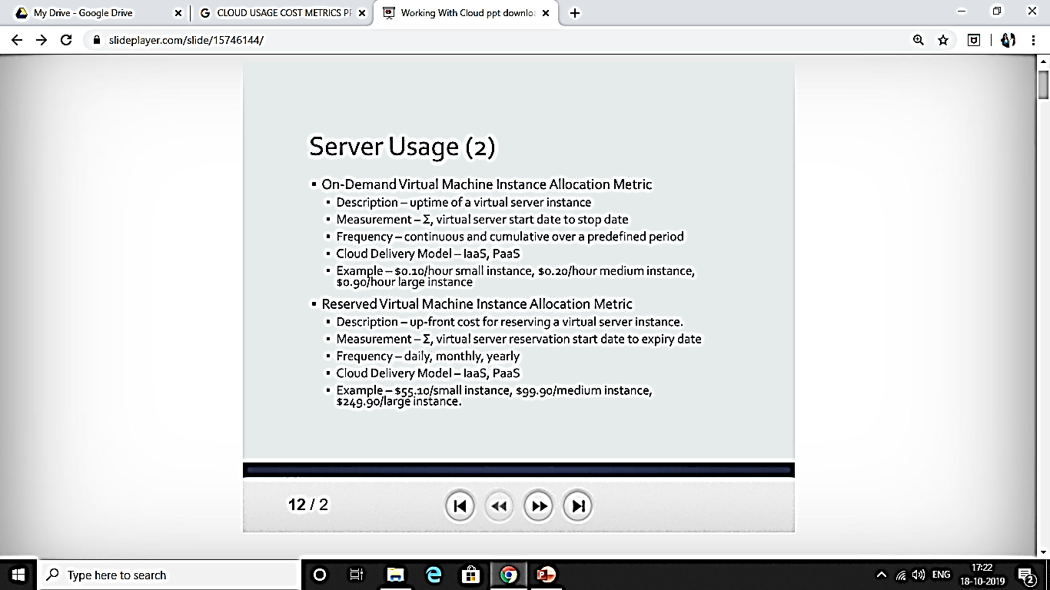

Slide 38
